Slide 1
CASE STUDY : SCAN DISK SCHEDULING ALGORITHM
BATCH NO : 18
Group Members :
208W1A1299
208W1A12C1
208W1A12C2
SUBMITTED TO :
Dr T Anuradha
IT Department

Slide 2
PROBLEM
Suppose that a disk drive has 5,000 cylinders, numbered 0 to 4,999. The drive is currently serving a request at cylinder 143 and the previous request was at cylinder 125. The queue of pending requests in FIFO order is 86, 1470, 913, 1774, 948, 1509, 1022, 1750, 130 Starting from the current head position, what is the total distance (in cylinders) that the disk arm moves to satisfy all pending requests for SCAN disk scheduling algorithms? Provide step by step solution in detail and develop program in C/ C++/ Python

Slide 3
SCAN DEFENITION
In SCAN algorithm the disk arm moves into a particular direction and services the requests coming in its path and after reaching the end of disk, it reverses its direction and again services the request arriving in its path. So, this algorithm works as an elevator and hence also known as elevator algorithm. As a result, the requests at the midrange are serviced more and those arriving behind the disk arm will have to wait.

Slide 4
SCAN ALGORITHM
Let Request array represents an array storing indexes of tracks that have been requested in ascending order of their time of arrival. ‘head’ is the position of disk head.
Let direction represents whether the head is moving towards left or right.
In the direction in which head is moving service all tracks one by one.
Calculate the absolute distance of the track from the head.
Increment the total seek count with this distance.
Currently serviced track position now becomes the new head position.
Go to step 3 until we reach at one of the ends of the disk.
If we reach at the end of the disk reverse the direction and go to step 2 until all tracks in request array have not been serviced.

Slide 5
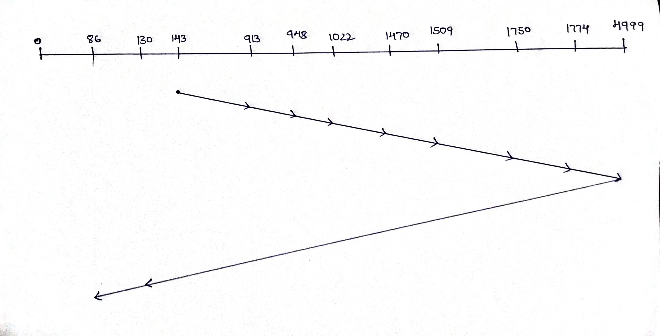
SOLUTION
Sequence Chart :
Therefore, the seek time is calculated as:
= (4999-143)+(4999-86) = 9769
∴ The number of seek operations = 9769

Slide 6
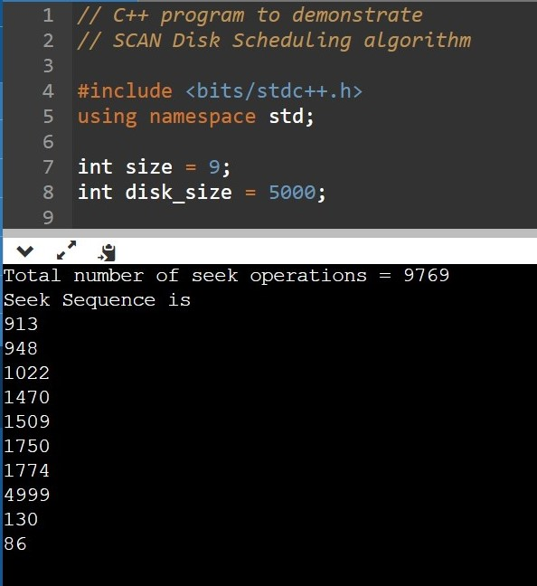
OUTPUT:

Slide 7
Thank you

